Slide 1
Artificial Intelligence Overview
An Introduction to AI Applications and Trends

Slide 2

Applications of AI
Healthcare
Autonomous Vehicles
Finance
Customer Service
Education

Slide 3
AI Market Growth

Slide 4
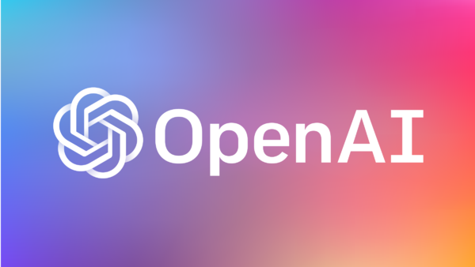
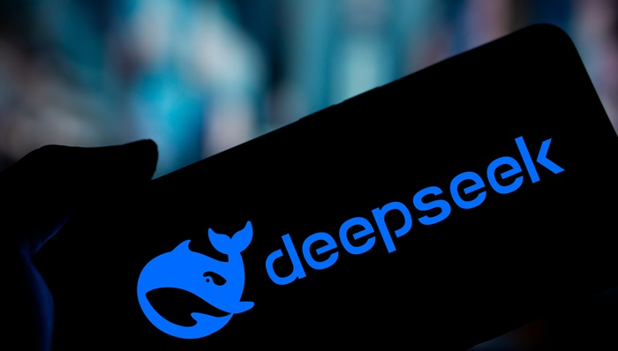
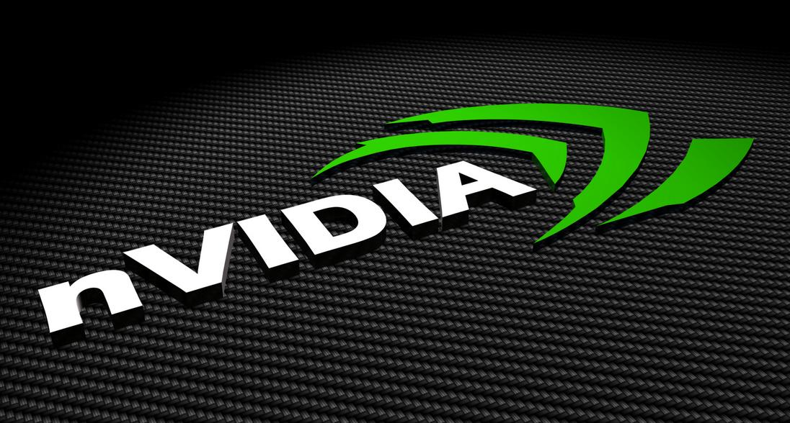
Top AI Companies
Company | Country | Specialization
OpenAI | USA | Generative AI
DeepMind | UK | Reinforcement Learning
NVIDIA | USA | AI Hardware
DeepSeek | china | Generative AiI

Slide 5
Learn More
Click here to visit OpenAI's website
Click here to visit DeepSeek website
Click here to visit nvidia website

